Slide 1
Comparing 3 brands of Aspirin Pills
Analysis by: Gavin Gunawardena
Using dataset from: LC-MS/MS in the Clinical Laboratory – Where to From Here?
by Stefan KG Greve and Ravinder J Singh and which can be found here: https://www.ncbi.nlm.nih.gov/pmc/articles/PMC3052391/

Slide 2
Intro
Background and Dataset
Machine generated dataset analyzing the chemical make-up and intensities of three brands of aspirin pills
Dataset consists of:
3 pills from 3 different brands of aspiring (Bayer, PV, and Walgreens)
Dataset consists of 63 tsv files grouping the pills by brand, peak of intensity, replicant, and aliquot
There are 3 aliquots for each replicant, 3 replicants for each peak, and 7 peaks for each brand in the dataset
Peak: time when the intensity of each pill is at its highest, usually when a chemical is released from the pill, usually at artificially timed intervals
Replicant: replicas of the same pill; 3 replicas of 3 different brands have been tested
Aliquots: Series of measurements within a timeframe of less than a second

Slide 3
Intro
Objective and Assumptions
Objective is to test the null hypothesis that the 3 brands of aspiring are the same with a 95% confidence interval
Plan is to measure the Area Under a Peak (AUP) for each aliquot of each replicant
Next, run various ANOVA analyses to compare the AUPs between brands for each peak to confirm or deny the null hypothesis
Assumptions:
Data was gathered using a standardized process, since it was machine generated
There is still some possibility for error within the process utilized to attain the data
Thus, missing data will be removed, and statistical tests will be run with and without outliers.

Slide 4
Exploratory Analysis
Dataset Summary
## Brand Peak Replicant Aliquot ## Length:4798 Length:4798 Min. :1.00 Min. :1.000 ## Class :character Class :character 1st Qu.:1.00 1st Qu.:1.000 ## Mode :character Mode :character Median :2.00 Median :2.000 ## Mean :1.99 Mean :2.003 ## 3rd Qu.:3.00 3rd Qu.:3.000 ## Max. :3.00 Max. :3.000 ## Time Intensity ## Min. :2.303 Min. : 10 ## 1st Qu.:2.548 1st Qu.: 270 ## Median :2.720 Median : 785 ## Mean :2.717 Mean : 10071 ## 3rd Qu.:2.867 3rd Qu.: 2590 ## Max. :3.161 Max. :257870

Slide 5
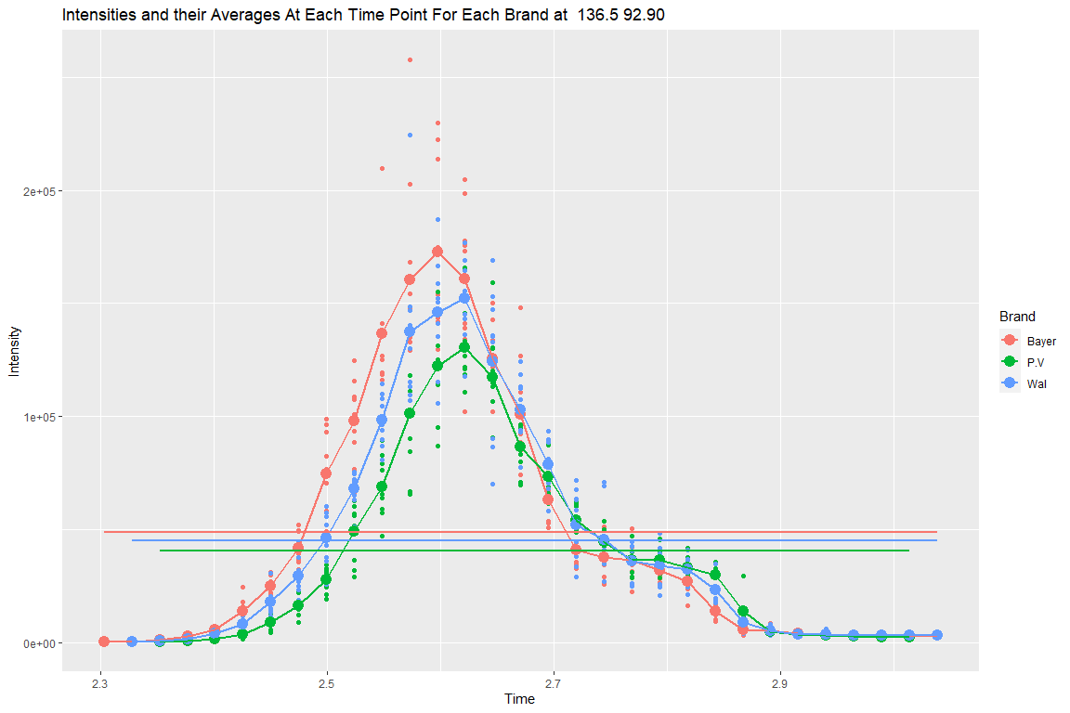
Exploratory Analysis

Slide 6
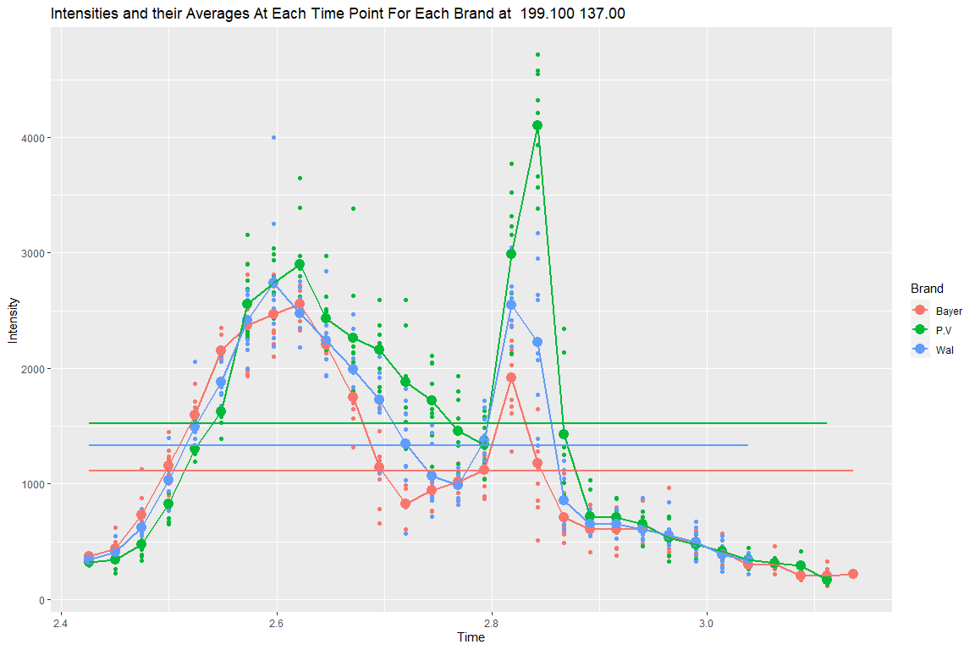
Exploratory Analysis

Slide 7
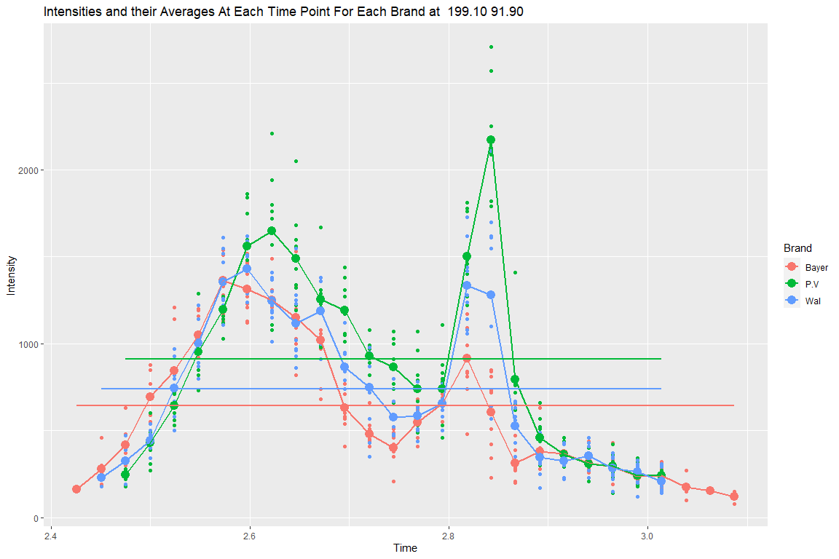
Exploratory Analysis

Slide 8
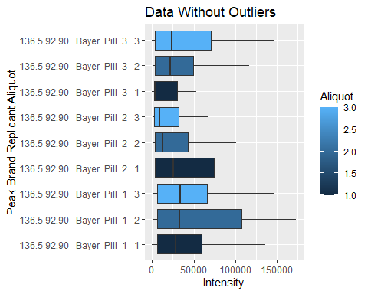
Exploratory Analysis

Slide 9
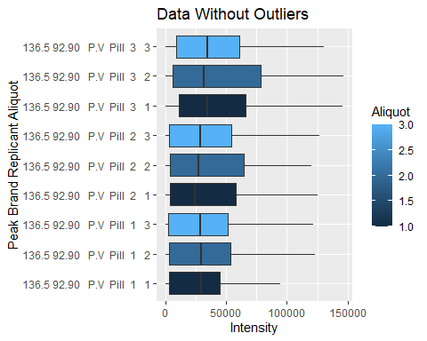
Exploratory Analysis

Slide 10
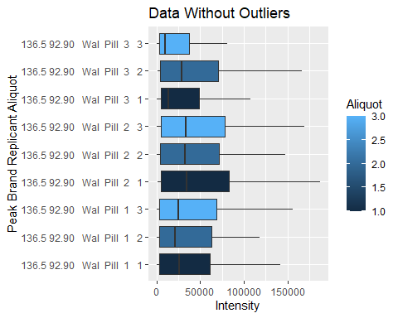
Exploratory Analysis

Slide 11
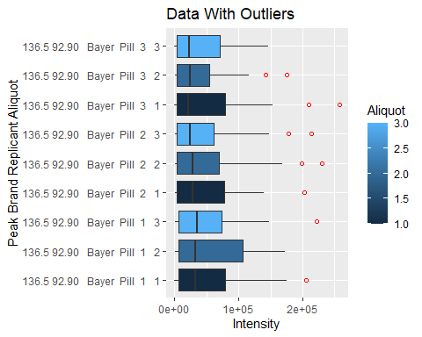
Exploratory Analysis

Slide 12
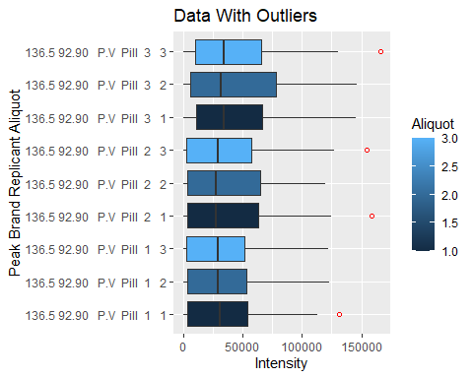
Exploratory Analysis

Slide 13
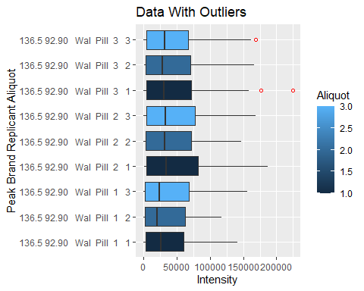
Exploratory Analysis

Slide 14
Analysis
One Way ANOVA and Pairwise comparisons of AUPs for each Brand
Complete with an alpha of .5 to get a 95% confidence interval statistical significance comparison
All 3 at once and pairwise comparisons using Student’s t-distribution tests
Brand | AoV_P_Value | Pairwise_T_Test_P_Value
Brand - With Outliers | 0.973
Brand - w/o Outliers | 0.729
P.V. vs Bayer - With Outliers |  | 0.85
Wal vs Bayer - With Outliers |  | 0.98
Wal vs P.V. - With Outliers |  | 0.83
P.V. vs Bayer - w/o Outliers |  | 0.53
Wal vs Bayer - w/o Outliers |  | 0.46
Wal vs P.V - w/o Outliers |  | 0.91

Slide 15
Analysis
Ad-Hoc Pairwise comparisons
Tukey-Kramer comparison which has an error correction that assists when comparing pairs within a group with sample sizes that aren’t exactly the same.
Bonferroni comparison which has an error correction that, similarly to the Tukey-Kramer test, also assists when comparing pairs within a group with sample sizes that aren’t exactly the same.
Brand | Tukey_Kramer_P_Values | Bonferroni_P_Values
P.V. vs Bayer - With Outliers | 0.489 | 0.818
Wal vs Bayer - With Outliers | 0.984 | 0.887
Wal vs P.V. - With Outliers | 0.389 | 0.118
P.V. vs Bayer - w/o Outliers | 0.078 | 0.140
Wal vs Bayer - w/o Outliers | 0.030 | 0.132
Wal vs P.V - w/o Oultiers | 0.924 | 0.624

Slide 16
Conclusions
Null Hypothesis that the Aspirin Pills Are the Same
Failed to reject null hypothesis that the aspirin pills are the same
Initial ANOVA test revealed that at a 95% confidence interval, there is no difference between the brands with or without the outliers being removed
This result was confirmed when running pairwise t-tests between the 3 brands
Ad-Hoc Analysis
When outliers are not removed and when comparing the individual brands between each other using either Tukey-Kramer or Bonferroni analyses, the null hypothesis is not rejected at a 95% confidence interval
When outliers are removed and the Tukey-Kramer analysis but not the Bonferroni analysis is used, the Walgreens and Bayers brand aspirin pills are found to be different at a 95% confidence interval, rejecting the null hypothesis
Standard One-Way ANOVA is being prioritized and thus the null hypothesis fails to be rejected

Slide 17
Sources
https://www.vedantu.com/formula/anova-formula
https://www.educba.com/t-test-formula/
https://www.statology.org/tukey-vs-bonferroni-vs-scheffe/
https://aaronschlegel.me/tukeys-test-post-hoc-analysis.html
https://www.itl.nist.gov/div898/handbook/prc/section4/prc473.htm
https://www.ncbi.nlm.nih.gov/pmc/articles/PMC3052391/

